Slide 1



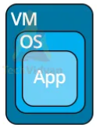


Komunikasi Data &&& Jaringan Komputer
Network Communication
PDS
Computer Vision
Transmisi Data
Pengkodean Data
Teknik Komunikasi Data Digital
Data Link Control
Multiplexing
Switching
Medium Access Sublayer
Multiple Access Control (MAC) Protocols
Network Layer
@ P. Siagian
Medium Access Sublayer
https://github.com/siagianp
https://www.youtube.com/@AmelOline/videos
https://github.com/amelcharolinesgn2/IoT_simulator-mqtt-NodeRed
github.com/amelcharolinesgn2/ANJAR

Slide 2
Design Challenges in WMNs
Hidden terminal problem
Exposed terminal problem
Control and management have to be distributed across all nodes.
Multichannel networks:
distributed channel selection
channel assignment

Slide 3
Early MAC Schemes

Slide 4
ALOHA
developed for packet radio nets
when station has frame, it sends
then listens for a bit over max round trip time
if receive ACK then fine
if not, retransmit
if no ACK after repeated transmissions, give up
uses a frame check sequence (as in HDLC)
frame may be damaged by noise or by another station transmitting at the same time (collision)
any overlap of frames causes collision
max utilization 18%
Notes:
The earliest of these techniques, known as ALOHA, was developed for packet radio networks. However, it is applicable to any shared transmission medium. ALOHA, or pure ALOHA as it is sometimes called, specifies that a station may transmit a frame at any time. The station then listens for an amount of time equal to the maximum possible round-trip propagation delay on the network (twice the time it takes to send a frame between the two most widely separated stations) plus a small fixed time increment. If the station hears an acknowledgment during that time, fine; otherwise, it resends the frame. If the station fails to receive an acknowledgment after repeated transmissions, it gives up. A receiving station determines the correctness of an incoming frame by examining a frame check sequence field, as in HDLC. If the frame is valid and if the destination address in the frame header matches the receiver's address, the station immediately sends an acknowledgment. The frame may be invalid due to noise on the channel or because another station transmitted a frame at about the same time. In the latter case, the two frames may interfere with each other at the receiver so that neither gets through; this is known as a collision. If a received frame is determined to be invalid, the receiving station simply ignores the frame. ALOHA is as simple as can be, and pays a penalty for it. Because the number of collisions rises rapidly with increased load, the maximum utilization of the channel is only about 18%.

Slide 5
Slotted ALOHA
time on channel based on uniform slots equal to frame transmission time
need central clock (or other sync mechanism)
transmission begins at slot boundary
frames either miss or overlap totally
max utilization 37%
both have poor utilization
fail to use fact that propagation time is much less than frame transmission time
Notes:
To improve efficiency, a modification of ALOHA, known as slotted ALOHA, was developed. In this scheme, time on the channel is organized into uniform slots whose size equals the frame transmission time. Some central clock or other technique is needed to synchronize all stations. Transmission is permitted to begin only at a slot boundary. Thus, frames that do overlap will do so totally. This increases the maximum utilization of the system to about 37%. Both ALOHA and slotted ALOHA exhibit poor utilization. Both fail to take advantage of one of the key properties of both packet radio networks and LANs, which is that propagation delay between stations may be very small compared to frame transmission time.

Slide 6
CSMA/CD
IEEE 802.3 MAC (Ethernet)

Slide 7
Ethernet (CSMA/CD)
most widely used LAN standard
developed by
Xerox - original Ethernet
IEEE 802.3
Carrier Sense Multiple Access with Collision Detection (CSMA/CD)
random / contention access to media
Notes:
The most widely used high-speed LANs today are based on Ethernet and were developed by the IEEE 802.3 standards committee. As with other LAN standards, there is both a medium access control layer and a physical layer. The media access uses CSMA/CD. This and its precursors can be termed random access, or contention, techniques. They are random access in the sense that there is no predictable or scheduled time for any station to transmit; station transmissions are ordered randomly. They exhibit contention in the sense that stations contend for time on the shared medium.

Slide 8
CSMA
stations soon know transmission has started
so first listen for clear medium (carrier sense)
if medium idle, transmit
if two stations start at the same instant, collision
wait reasonable time
if no ACK then retransmit
collisions occur at leading edge of frame
max utilization depends on propagation time (medium length) and frame length
Notes:
The foregoing observations led to the development of carrier sense multiple access (CSMA). With CSMA, a station wishing to transmit first listens to the medium to determine if another transmission is in progress (carrier sense). If the medium is in use, the station must wait. If the medium is idle, the station may transmit. It may happen that two or more stations attempt to transmit at about the same time. If this happens, there will be a collision; the data from both transmissions will be garbled and not received successfully. To account for this, a station waits a reasonable amount of time after transmitting for an acknowledgment, taking into account the maximum round-trip propagation delay and the fact that the acknowledging station must also contend for the channel to respond. If there is no acknowledgment, the station assumes that a collision has occurred and retransmits. This strategy is effective for networks in which the average frame transmission time is much longer than the propagation time. Collisions can occur only when more than one user begins transmitting within a short time interval (the period of the propagation delay). If a station begins to transmit a frame, and there are no collisions during the time it takes for the leading edge of the packet to propagate to the farthest station, then there will be no collision for this frame because all other stations are now aware of the transmission. The maximum utilization achievable using CSMA can far exceed that of ALOHA or slotted ALOHA. The maximum utilization depends on the length of the frame and on the propagation time; the longer the frames or the shorter the propagation time, the higher the utilization.

Slide 9
Nonpersistent CSMA
Nonpersistent CSMA rules:
if medium idle, transmit
if medium busy, wait amount of time drawn from probability distribution (retransmission delay) & retry
random delays reduces probability of collisions
capacity is wasted because medium will remain idle following end of transmission
nonpersistent stations are deferential
Notes:
With CSMA, an algorithm is needed to specify what a station should do if the medium is found busy. One algorithm is nonpersistent CSMA. A station wishing to transmit listens to the medium and obeys the following rules:
1. If the medium is idle, transmit; otherwise, go to step 2.
2. If the medium is busy, wait an amount of time drawn from a probability distribution (the retransmission delay) and repeat step 1.
The use of random delays reduces the probability of collisions. To see this, consider that two stations become ready to transmit at about the same time while another transmission is in progress; if both stations delay the same amount of time before trying again, they will both attempt to transmit at about the same time. A problem with nonpersistent CSMA is that capacity is wasted because the medium will generally remain idle following the end of a transmission even if there are one or more stations waiting to transmit.

Slide 10
1-persistent CSMA
1-persistent CSMA avoids idle channel time
1-persistent CSMA rules:
if medium idle, transmit;
if medium busy, listen until idle; then transmit immediately
1-persistent stations are selfish
if two or more stations waiting, a collision is guaranteed
Notes:
To avoid idle channel time, the 1-persistent protocol can be used. A station wishing to transmit listens to the medium and obeys the following rules:
1. If the medium is idle, transmit; otherwise, go to step 2.
2. If the medium is busy, continue to listen until the channel is sensed idle; then transmit immediately.
Whereas nonpersistent stations are deferential, 1-persistent stations are selfish. If two or more stations are waiting to transmit, a collision is guaranteed. Things get sorted out only after the collision.

Slide 11
P-persistent CSMA
a compromise to try and reduce collisions and idle time
p-persistent CSMA rules:
if medium idle, transmit with probability p, and delay one time unit with probability (1–p)
if medium busy, listen until idle and repeat step 1
if transmission is delayed one time unit, repeat step 1
issue of choosing effective value of p to avoid instability under heavy load
Notes:
A compromise that attempts to reduce collisions, like nonpersistent, and reduce idle time, like 1-persistent, is p-persistent. The rules are:
1. If the medium is idle, transmit with probability p, and delay one time unit with probability (1 – p). The time unit is typically equal to the maximum propagation delay.
2. If the medium is busy, continue to listen until the channel is idle and repeat step 1.
3. If transmission is delayed one time unit, repeat step 1.
The question arises as to what is an effective value of p. The main problem to avoid is one of instability under heavy load.

Slide 12
Value of p?
have n stations waiting to send
at end of tx, expected no of stations is np
if np>1 on average there will be a collision
repeated tx attempts mean collisions likely
eventually when all stations trying to send have continuous collisions hence zero throughput
thus want np<1 for expected peaks of n
if heavy load expected, p small
but smaller p means stations wait longer
Notes:
Consider the case in which n stations have frames to send while a transmission is taking place. At the end of the transmission, the expected number of stations that will attempt to transmit is equal to the number of stations ready to transmit times the probability of transmitting, or np. If np is greater than 1, on average multiple stations will attempt to transmit and there will be a collision. What is more, as soon as all these stations realize that their transmission suffered a collision, they will be back again, almost guaranteeing more collisions. Worse yet, these retries will compete with new transmissions from other stations, further increasing the probability of collision. Eventually, all stations will be trying to send, causing continuous collisions, with throughput dropping to zero. To avoid this catastrophe, np must be less than one for the expected peaks of n; therefore, if a heavy load is expected to occur with some regularity, p must be small. However, as p is made smaller, stations must wait longer to attempt transmission. At low loads, this can result in very long delays. For example, if only a single station desires to transmit, the expected number of iterations of step 1 is 1/p. Thus, if p = 0.1, at low load, a station will wait an average of 9 time units before transmitting on an idle line.

Slide 13
CSMA/CD Description
with CSMA, collision occupies medium for duration of transmission
better if stations listen whilst transmitting
CSMA/CD rules:
if medium idle, transmit
if busy, listen for idle, then transmit
if collision detected, jam and then cease transmission
after jam, wait random time then retry
Notes:
CSMA, although more efficient than ALOHA or slotted ALOHA, still has one glaring inefficiency. When two frames collide, the medium remains unusable for the duration of transmission of both damaged frames. For long frames, compared to propagation time, the amount of wasted capacity can be considerable. This waste can be reduced if a station continues to listen to the medium while transmitting. This leads to the following rules for CSMA/CD:
1. If the medium is idle, transmit; otherwise, go to step 2.
2. If the medium is busy, continue to listen until the channel is idle, then transmit immediately.
3. If a collision is detected during transmission, transmit a brief jamming signal to assure that all stations know that there has been a collision and then cease transmission.
4. After transmitting the jamming signal, wait a random amount of time, referred to as the backoff, then attempt to transmit again (repeat from step 1).

Slide 14
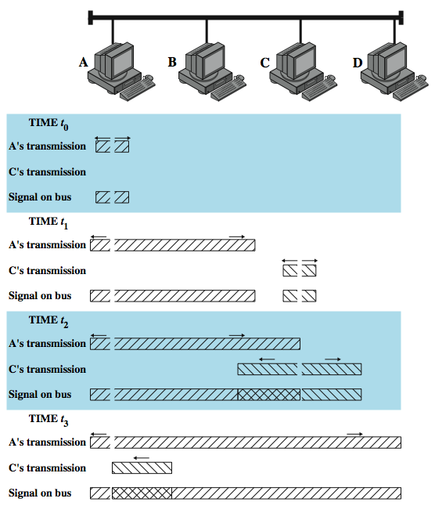
CSMA/CD Operation
Notes:
Stallings DCC8e Figure 16.2 illustrates the technique for a baseband bus. The upper part of the figure shows a bus LAN layout. At time t₀, station A begins transmitting a packet addressed to D. At t ₁, both B and C are ready to transmit. B senses a transmission and so defers. C, however, is still unaware of A's transmission (because the leading edge of A's transmission has not yet arrived at C) and begins its own transmission. When A's transmission reaches C, at t ₂, C detects the collision and ceases transmission. The effect of the collision propagates back to A, where it is detected some time later, t ₃, at which time A ceases transmission. With CSMA/CD, the amount of wasted capacity is reduced to the time it takes to detect a collision. Question: How long does that take? Let us consider the case of a baseband bus and consider two stations as far apart as possible. For example, in Figure 16.2, suppose that station A begins a transmission and that just before that transmission reaches D, D is ready to transmit. Because D is not yet aware of A's transmission, it begins to transmit. A collision occurs almost immediately and is recognized by D. However, the collision must propagate all the way back to A before A is aware of the collision. By this line of reasoning, we conclude that the amount of time that it takes to detect a collision is no greater than twice the end-to-end propagation delay.

Slide 15
Which Persistence Algorithm?
IEEE 802.3 uses 1-persistent
both nonpersistent and p-persistent have performance problems
1-persistent seems more unstable than p-persistent
because of greed of the stations
but wasted time due to collisions is short
with random backoff unlikely to collide on next attempt to send
Notes:
An important rule followed in most CSMA/CD systems, including the IEEE standard, is that frames should be long enough to allow collision detection prior to the end of transmission. If shorter frames are used, then collision detection does not occur, and CSMA/CD exhibits the same performance as the less efficient CSMA protocol. For a CSMA/CD LAN, the question arises as to which persistence algorithm to use. You may be surprised to learn that the algorithm used in the IEEE 802.3 standard is 1-persistent. Recall that both nonpersistent and p-persistent have performance problems. In the nonpersistent case, capacity is wasted because the medium will generally remain idle following the end of a transmission even if there are stations waiting to send. In the p-persistent case, p must be set low enough to avoid instability, with the result of sometimes atrocious delays under light load. The 1-persistent algorithm, which means, after all, that p = 1, would seem to be even more unstable than p-persistent due to the greed of the stations. What saves the day is that the wasted time due to collisions is mercifully short (if the frames are long relative to propagation delay), and with random backoff, the two stations involved in a collision are unlikely to collide on their next tries.

Slide 16
Binary Exponential Backoff
for backoff stability, IEEE 802.3 and Ethernet both use binary exponential backoff
stations repeatedly resend when collide
on first 10 attempts, mean random delay doubled
value then remains same for 6 further attempts
after 16 unsuccessful attempts, station gives up and reports error
1-persistent algorithm with binary exponential backoff efficient over wide range of loads
but backoff algorithm has last-in, first-out effect
Notes:
To ensure that backoff maintains stability, IEEE 802.3 and Ethernet use a technique known as binary exponential backoff. A station will attempt to transmit repeatedly in the face of repeated collisions. For the first 10 retransmission attempts, the mean value of the random delay is doubled. This mean value then remains the same for 6 additional attempts. After 16 unsuccessful attempts, the station gives up and reports an error. Thus, as congestion increases, stations back off by larger and larger amounts to reduce the probability of collision. The beauty of the 1-persistent algorithm with binary exponential backoff is that it is efficient over a wide range of loads. At low loads, 1-persistence guarantees that a station can seize the channel as soon as it goes idle, in contrast to the non- and p-persistent schemes. At high loads, it is at least as stable as the other techniques. However, one unfortunate effect of the backoff algorithm is that it has a last-in first-out effect; stations with no or few collisions will have a chance to transmit before stations that have waited longer.

Slide 17
Collision Detection
on baseband bus
collision produces higher signal voltage
collision detected if cable signal greater than single station signal
signal is attenuated over distance
limit to 500m (10Base5) or 200m (10Base2)
on twisted pair (star-topology)
activity on more than one port is collision
use special collision presence signal
Notes:
For baseband bus, a collision should produce substantially higher voltage swings than those produced by a single transmitter. Accordingly, the IEEE standard dictates that the transmitter will detect a collision if the signal on the cable at the transmitter tap point exceeds the maximum that could be produced by the transmitter alone. Because a transmitted signal attenuates as it propagates, there is a potential problem: If two stations far apart are transmitting, each station will receive a greatly attenuated signal from the other. The signal strength could be so small that when it is added to the transmitted signal at the transmitter tap point, the combined signal does not exceed the CD threshold. For this reason, among others, the IEEE standard restricts the maximum length of coaxial cable to 500 m for 10BASE5 and 200 m for 10BASE2.
A much simpler collision detection scheme is possible with the twisted-pair star-topology approach. In this case, collision detection is based on logic rather than sensing voltage magnitudes. For any hub, if there is activity (signal) on more than one input, a collision is assumed. A special signal called the collision presence signal is generated. This signal is generated and sent out as long as activity is sensed on any of the input lines. This signal is interpreted by every node as an occurrence of a collision.

Slide 18
CSMA/CA
IEEE 802.11 MAC

Slide 19
Medium Access Control
MAC layer covers three functional areas
reliable data delivery
access control
security
Notes:
The IEEE 802.11 MAC layer covers three functional areas: reliable data delivery, access control, and security. This section covers the first two topics.

Slide 20
Reliable Data Delivery
802.11 physical / MAC layers unreliable
noise, interference, and other propagation effects result in loss of frames
even with error-correction codes, frames may not successfully be received
can be dealt with at a higher layer, e.g. TCP
more efficient to deal with errors at MAC level
802.11 includes frame exchange protocol
station receiving frame returns acknowledgment (ACK) frame
exchange treated as atomic unit
if no ACK within short period of time, retransmit
Notes:
As with any wireless network, a wireless LAN using the IEEE 802.11 physical and MAC layers is subject to considerable unreliability. Noise, interference, and other propagation effects result in the loss of a significant number of frames. Even with error correction codes, a number of MAC frames may not successfully be received. This situation can be dealt with by reliability mechanisms at a higher layer, such as TCP. However, timers used for retransmission at higher layers are typically on the order of seconds. It is therefore more efficient to deal with errors at the MAC level. For this purpose, IEEE 802.11 includes a frame exchange protocol. When a station receives a data frame from another station, it returns an acknowledgment (ACK) frame to the source station. This exchange is treated as an atomic unit, not to be interrupted by a transmission from any other station. If the source does not receive an ACK within a short period of time, either because its data frame was damaged or because the returning ACK was damaged, the source retransmits the frame.

Slide 21
Four Frame Exchange
Can use four-frame exchange for better reliability
source issues a Request to Send (RTS) frame to dest
destination responds with Clear to Send (CTS)
after receiving CTS, source transmits data
destination responds with ACK
RTS alerts all stations within range of source that exchange is under way
CTS alerts all stations within range of destination
Other stations don’t transmit to avoid collision
RTS/CTS exchange is required function of MAC but may be disabled
Notes:
Thus, the basic data transfer mechanism in IEEE 802.11 involves an exchange of two frames. To further enhance reliability, a four-frame exchange may be used. In this scheme, a source first issues a Request to Send (RTS) frame to the destination. The destination then responds with a Clear to Send (CTS). After receiving the CTS, the source transmits the data frame, and the destination responds with an ACK. The RTS alerts all stations that are within reception range of the source that an exchange is under way; these stations refrain from transmission in order to avoid a collision between two frames transmitted at the same time. Similarly, the CTS alerts all stations that are within reception range of the destination that an exchange is under way. The RTS/CTS portion of the exchange is a required function of the MAC but may be disabled.

Slide 22
CSMA/CA
Fig. 6.70 (Leon-Garcia)

Slide 23
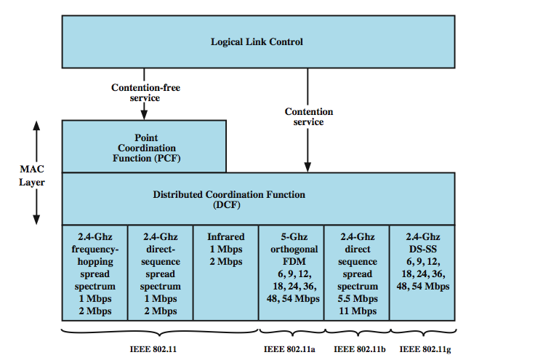
Media Access Control
Notes:
The 802.11 working group considered two types of proposals for a MAC algorithm: distributed access protocols, which, like Ethernet, distribute the decision to transmit over all the nodes using a carrier sense mechanism; and centralized access protocols, which involve regulation of transmission by a centralized decision maker. A distributed access protocol makes sense for an ad hoc network of peer workstations (typically an IBSS) and may also be attractive in other wireless LAN configurations that consist primarily of bursty traffic. A centralized access protocol is natural for configurations in which a number of wireless stations are interconnected with each other and some sort of base station that attaches to a backbone wired LAN; it is especially useful if some of the data is time sensitive or high priority. The end result for 802.11 is a MAC algorithm called DFWMAC (distributed foundation wireless MAC) that provides a distributed access control mechanism with an optional centralized control built on top of that.
Stallings DCC8e Figure 17.5 illustrates the architecture. The lower sublayer of the MAC layer is the distributed coordination function (DCF). DCF uses a contention algorithm to provide access to all traffic. Ordinary asynchronous traffic directly uses DCF. The point coordination function (PCF) is a centralized MAC algorithm used to provide contention-free service. PCF is built on top of DCF and exploits features of DCF to assure access for its users.

Slide 24
Distributed Coordination Function
DCF sublayer uses CSMA
if station has frame to send it listens to medium
if medium idle, station may transmit
else waits until current transmission complete
No collision detection since on wireless network
DCF includes delays that act as a priority scheme
Notes:
The DCF sublayer makes use of a simple CSMA (carrier sense multiple access) algorithm. If a station has a MAC frame to transmit, it listens to the medium. If the medium is idle, the station may transmit; otherwise the station must wait until the current transmission is complete before transmitting. The DCF does not include a collision detection function (i.e., CSMA/CD) because collision detection is not practical on a wireless network. The dynamic range of the signals on the medium is very large, so that a transmitting station cannot effectively distinguish incoming weak signals from noise and the effects of its own transmission. To ensure the smooth and fair functioning of this algorithm, DCF includes a set of delays that amounts to a priority scheme. Let us start by considering a single delay known as an interframe space (IFS). In fact, there are three different IFS values, but the algorithm is best explained by initially ignoring this detail.

Slide 25
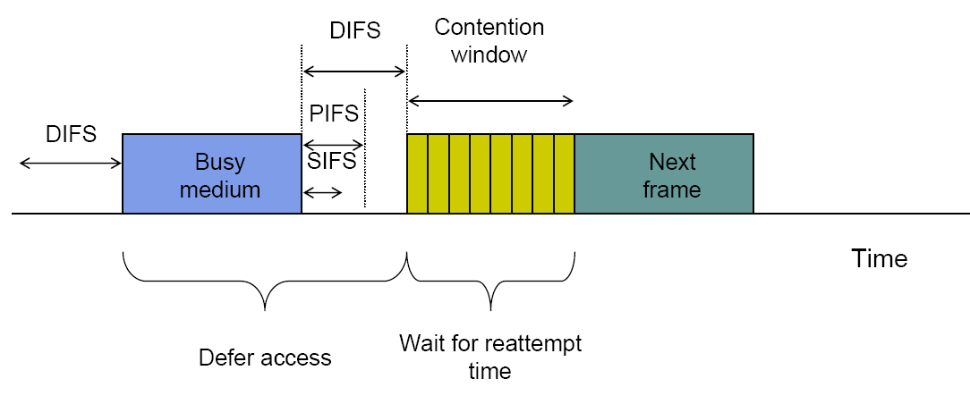
Basic CSMA/CA operations
Fig. 6.69 (Leon-Garcia)

Slide 26
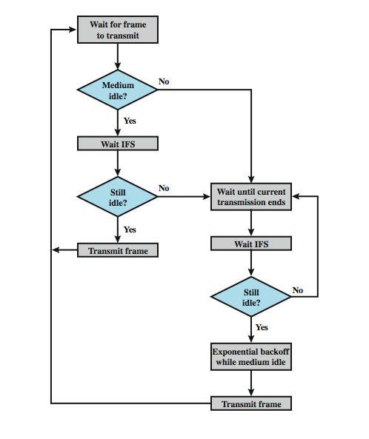
IEEE 802.11 Medium Access Control Logic
Notes:
Using an IFS, the rules for CSMA access are as follows (Stallings DCC8e Figure 17.6):
1. A station with a frame to transmit senses the medium. If the medium is idle, it waits to see if the medium remains idle for a time equal to IFS. If so, the station may transmit immediately.
2. If the medium is busy (either because the station initially finds the medium busy or because the medium becomes busy during the IFS idle time), the station defers transmission and continues to monitor the medium until the current transmission is over.
3. Once the current transmission is over, the station delays another IFS. If the medium remains idle for this period, then the station backs off a random amount of time and again senses the medium. If the medium is still idle, the station may transmit. During the backoff time, if the medium becomes busy, the backoff timer is halted and resumes when the medium becomes idle.
4.If the transmission is unsuccessful, which is determined by the absence of an acknowledgement, then it is assumed that a collision has occurred.
To ensure that backoff maintains stability, binary exponential backoff, described in Chapter 16, is used. Binary exponential backoff provides a means of handling a heavy load. Repeated failed attempts to transmit result in longer and longer backoff times, which helps to smooth out the load. Without such a backoff, the following situation could occur: Two or more stations attempt to transmit at the same time, causing a collision. These stations then immediately attempt to retransmit, causing a new collision.

Slide 27
Transmission without RTS/CTS
Fig. 6.71 (Leon-Garcia)

Slide 28
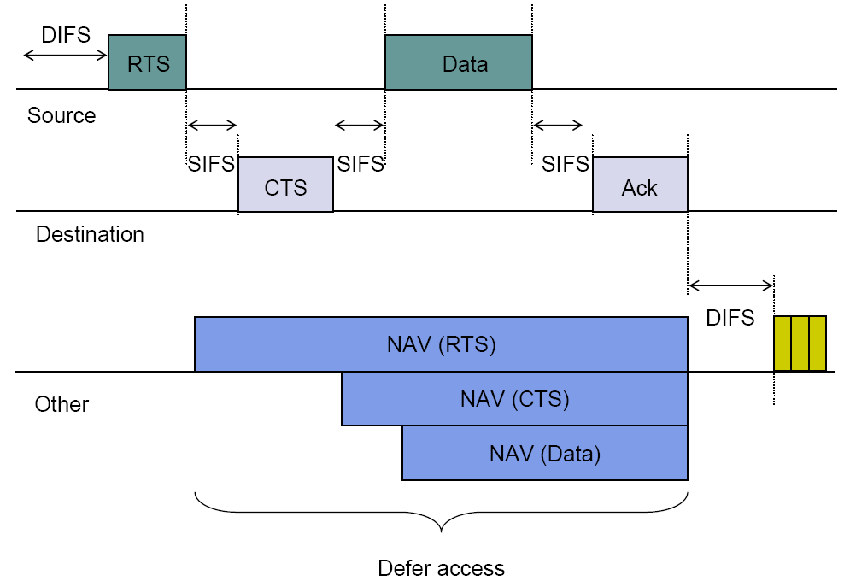
Transmission with RTS/CTS
Fig. 6.72 (Leon-Garcia)

Slide 29
Priority IFS Values
SIFS (short IFS)
for all immediate response actions (see later)
PIFS (point coordination function IFS)
used by the centralized controller in PCF scheme when issuing polls
DIFS (distributed coordination function IFS)
used as minimum delay for asynchronous frames contending for access
Notes:
The preceding scheme is refined for DCF to provide priority-based access by the simple expedient of using three values for IFS:
• SIFS (short IFS): The shortest IFS, used for all immediate response actions, as explained in the following discussion
• PIFS (point coordination function IFS): A midlength IFS, used by the centralized controller in the PCF scheme when issuing polls
• DIFS (distributed coordination function IFS): The longest IFS, used as a minimum delay for asynchronous frames contending for access

Slide 30
SIFS Use
SIFS gives highest priority
over stations waiting PIFS or DIFS time
SIFS used in following circumstances:
Acknowledgment (ACK)
station responds with ACK after waiting SIFS gap
for efficient collision detect & multi-frame transmission
Clear to Send (CTS)
station ensures data frame gets through by issuing RTS
and waits for CTS response from destination
Poll response
see Point coordination Function (PCF) discussion next
Notes:
Consider first the SIFS. Any station using SIFS to determine transmission opportunity has, in effect, the highest priority, because it will always gain access in preference to a station waiting an amount of time equal to PIFS or DIFS. The SIFS is used in the following circumstances:
• Acknowledgment (ACK): When a station receives a frame addressed only to itself (not multicast or broadcast), it responds with an ACK frame after waiting only for an SIFS gap. This has two desirable effects. First, because collision detection is not used, the likelihood of collisions is greater than with CSMA/CD, and the MAC-level ACK provides for efficient collision recovery. Second, the SIFS can be used to provide efficient delivery of an LLC protocol data unit (PDU) that requires multiple MAC frames. In this case, the following scenario occurs. A station with a multiframe LLC PDU to transmit sends out the MAC frames one at a time. Each frame is acknowledged by the recipient after SIFS. When the source receives an ACK, it immediately (after SIFS) sends the next frame in the sequence. The result is that once a station has contended for the channel, it will maintain control of the channel until it has sent all of the fragments of an LLC PDU.
• Clear to Send (CTS): A station can ensure that its data frame will get through by first issuing a small Request to Send (RTS) frame. The station to which this frame is addressed should immediately respond with a CTS frame if it is ready to receive. All other stations receive the RTS and defer using the medium.
• Poll response: This is explained in the following discussion of PCF.

Slide 31
PIFS and DIFS Use
PIFS used by centralized controller
for issuing polls
has precedence over normal contention traffic
but not SIFS
DIFS used for all ordinary asynchronous traffic
Notes:
The next longest IFS interval is the PIFS. This is used by the centralized controller in issuing polls and takes precedence over normal contention traffic. However, those frames transmitted using SIFS have precedence over a PCF poll.
Finally, the DIFS interval is used for all ordinary asynchronous traffic.

Slide 32
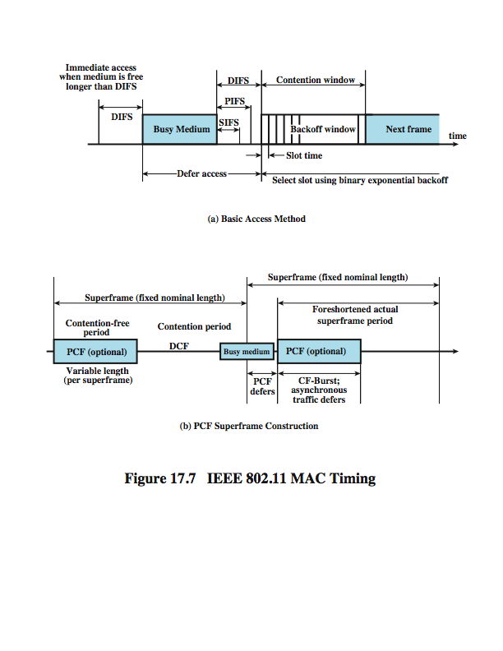
IEEE 802.11 MAC Timing Basic Access Method
Notes:
Stallings DCC8e Figure 17.7a illustrates the use of these time values.

Slide 33
Point Coordination Function (PCF)
alternative access method implemented on top of DCF
polling by centralized polling master (point coordinator)
uses PIFS when issuing polls
point coordinator polls in round-robin to stations configured for polling
when poll issued, polled station may respond using SIFS
if point coordinator receives response, it issues another poll using PIFS
if no response during expected turnaround time, coordinator issues poll
coordinator could lock out async traffic by issuing polls
have a superframe interval defined
not suitable for use in WMNs
Notes:
PCF is an alternative access method implemented on top of the DCF. The operation consists of polling by the centralized polling master (point coordinator). The point coordinator makes use of PIFS when issuing polls. Because PIFS is smaller than DIFS, the point coordinator can seize the medium and lock out all asynchronous traffic while it issues polls and receives responses.
As an extreme, consider the following possible scenario. A wireless network is configured so that a number of stations with time-sensitive traffic are controlled by the point coordinator while remaining traffic contends for access using CSMA. The point coordinator could issue polls in a round-robin fashion to all stations configured for polling. When a poll is issued, the polled station may respond using SIFS. If the point coordinator receives a response, it issues another poll using PIFS. If no response is received during the expected turnaround time, the coordinator issues a poll.
If the discipline of the preceding paragraph were implemented, the point coordinator would lock out all asynchronous traffic by repeatedly issuing polls. To prevent this, an interval known as the superframe is defined. During the first part of this interval, the point coordinator issues polls in a round-robin fashion to all stations configured for polling. The point coordinator then idles for the remainder of the superframe, allowing a contention period for asynchronous access.

Slide 34
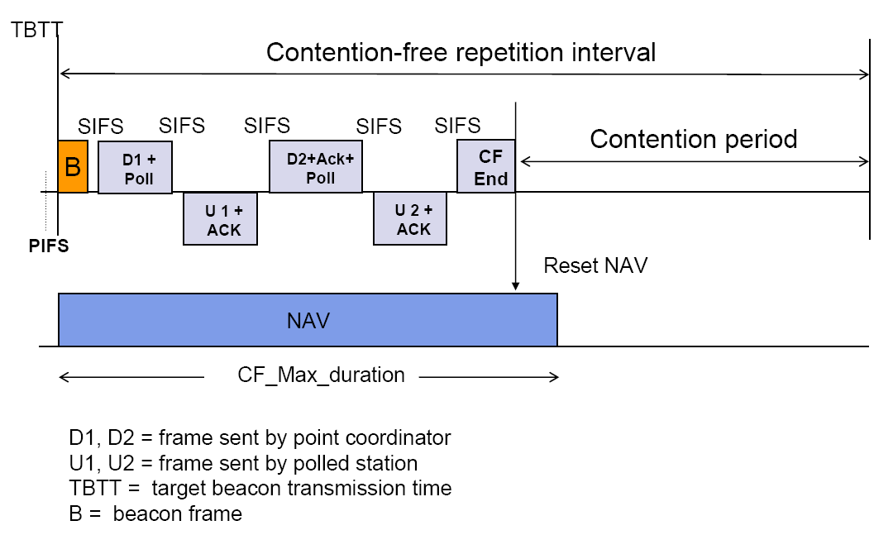
Point coordination frame transfer
Fig. 6.73 (Leon-Garcia)

Slide 35
PCF Superframe Timing
Notes:
Stallings DCC8e Figure 17.7b illustrates the use of the superframe. At the beginning of a superframe, the point coordinator may optionally seize control and issue polls for a given period of time. This interval varies because of the variable frame size issued by responding stations. The remainder of the superframe is available for contention-based access. At the end of the superframe interval, the point coordinator contends for access to the medium using PIFS. If the medium is idle, the point coordinator gains immediate access and a full superframe period follows. However, the medium may be busy at the end of a superframe. In this case, the point coordinator must wait until the medium is idle to gain access; this results in a foreshortened superframe period for the next cycle.

Slide 36
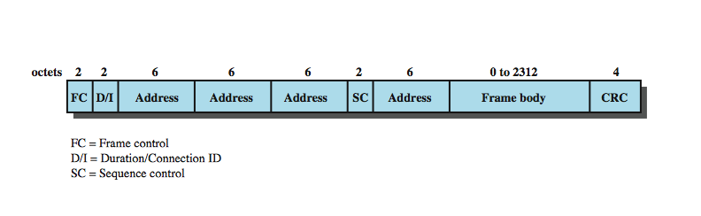
IEEE 802.11 MAC Frame Format
Notes:
Stallings DCC8e Figure 17.8 shows the 802.11 frame format. This general format is used for all data and control frames, but not all fields are used in all contexts. The fields are:
• Frame Control: Indicates the type of frame (control, management, or data) and provides control information. Control information includes whether the frame is to or from a DS, fragmentation information, and privacy information.
• Duration/Connection ID: If used as a duration field, indicates the time (in microseconds) the channel will be allocated for successful transmission of a MAC frame. In some control frames, this field contains an association, or connection, identifier.
• Addresses: The number and meaning of the 48-bit address fields depend on context. The transmitter address and receiver address are the MAC addresses of stations joined to the BSS that are transmitting and receiving frames over the wireless LAN. The service set ID (SSID) identifies the wireless LAN over which a frame is transmitted.
• Sequence Control: Contains a 4-bit fragment number subfield, used for fragmentation and reassembly, and a 12-bit sequence number used to number frames sent between a given transmitter and receiver.
• Frame Body: Contains an MSDU or a fragment of an MSDU. The MSDU is a LLC protocol data unit or MAC control information.
• Frame Check Sequence: A 32-bit cyclic redundancy check.

Slide 37
Control Frames
Power Save-Poll (PS-Poll)
request AP transmit buffered frame when in power-saving mode
Request to Send (RTS)
first frame in four-way frame exchange
Clear to Send (CTS)
second frame in four-way exchange
Acknowledgment (ACK)
Contention-Free (CF)-end
announces end of contention-free period part of PCF
CF-End + CF-Ack:
acknowledges CF-end to end contention-free period and release stations from associated restrictions
Notes:
We now look at the three MAC frame types. Control frames assist in the reliable delivery of data frames. There are six control frame subtypes:
• Power Save-Poll (PS-Poll): This frame is sent by any station to the station that includes the AP (access point). Its purpose is to request that the AP transmit a frame that has been buffered for this station while the station was in power-saving mode.
• Request to Send (RTS): This is the first frame in the four-way frame exchange discussed under the subsection on reliable data delivery at the beginning of Section 17.3. The station sending this message is alerting a potential destination, and all other stations within reception range, that it intends to send a data frame to that destination.
• Clear to Send (CTS): This is the second frame in the four-way exchange. It is sent by the destination station to the source station to grant permission to send a data frame.
• Acknowledgment: Provides an acknowledgment from the destination to the source that the immediately preceding data, management, or PS-Poll frame was received correctly.
• Contention-Free (CF)-end: Announces the end of a contention-free period that is part of the point coordination function.
• CF-End + CF-Ack: Acknowledges the CF-end. This frame ends the contention-free period and releases stations from the restrictions associated with that period.

Slide 38
Data Frames – Data Carrying
eight data frame subtypes, in two groups
first four carry upper-level data
Data
simplest data frame, contention or contention-free use
Data + CF-Ack
carries data and acknowledges previously received data during contention-free period
Data + CF-Poll
used by point coordinator to deliver data & req send
Data + CF-Ack + CF-Poll
combines Data + CF-Ack and Data + CF-Poll
Notes:
There are eight data frame subtypes, organized into two groups. The first four subtypes define frames that carry upper-level data from the source station to the destination station. The four data-carrying frames are:
• Data: This is the simplest data frame. It may be used in both a contention period and a contention-free period.
• Data + CF-Ack: May only be sent during a contention-free period. In addition to carrying data, this frame acknowledges previously received data.
• Data + CF-Poll: Used by a point coordinator to deliver data to a mobile station and also to request that the mobile station send a data frame that it may have buffered.
• Data + CF-Ack + CF-Poll: Combines the functions of the Data + CF-Ack and Data + CF-Poll into a single frame.

Slide 39
Data Frames – Not Data Carrying
other four data frames do not carry user data
Null Function
carries no data, polls, or acknowledgments
carries power mgmt bit in frame control field to AP
indicates station is changing to low-power state
other three frames (CF-Ack, CF-Poll, CF-Ack + CF-Poll) same as corresponding frame in preceding list but without data
Notes:
The remaining four subtypes of data frames do not in fact carry any user data. The Null Function data frame carries no data, polls, or acknowledgments. It is used only to carry the power management bit in the frame control field to the AP, to indicate that the station is changing to a low-power operating state. The remaining three frames (CF-Ack, CF-Poll, CF-Ack + CF-Poll) have the same functionality as the corresponding data frame subtypes in the preceding list (Data + CF-Ack, Data + CF-Poll, Data + CF-Ack + CF-Poll) but without the data.

Slide 40
Management Frames
used to manage communications between stations and APs
such as management of associations
requests, response, reassociation, dissociation, and authentication
Notes:
Management frames are used to manage communications between stations and APs. Functions covered include management of associations (request, response, reassociation, dissociation, and authentication.

Slide 41
IEEE 802.11e MAC

Slide 42
802.11e MAC
Defines a number of QoS enhancements to 802.11 MAC
See short descriptions at wikipedia.org

Slide 43
QoS Limitations of 802.11
DCF (Distributed Coordination Function)
Only support best-effort services
No guarantee in bandwidth, packet delay and jitter
Throughput degradation in the heavy load
PCF (Point Coordination Function)
Inefficient central polling scheme
Unpredictable beacon frame delay due to incompatible cooperation between CP and CFP modes
Transmission time of the polled stations is unknown

Slide 44
Overview of 802.11e
Formed in Sept. 1999.
The first draft was available in late 2001
Aims to support both IntServ and DiffServ
New QoS mechanisms − HCF (Hybrid Coordination Function): 2 modes
EDCA (Enhanced Distributed Channel Access )
contention-based, distributed
HCCA (HCF controlled channel access)
requires a central control entity and synchronization among nodes
not suitable for WMNs
Backward compatible with DCF and PCF

Slide 45
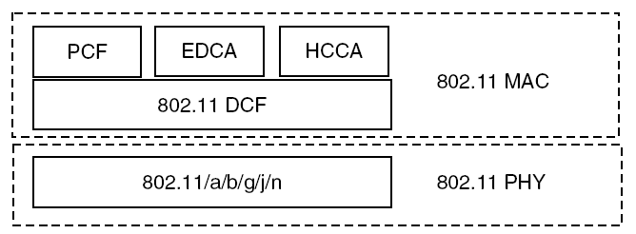
802.11e MAC architecture

Slide 46
Wireless Multimedia Extensions (WME)
a.k.a Wi-Fi Multimedia (WMM)
subset of 802.11e to be implemented by the industry
4 access categories (ACs): voice, video, best effort, and background
no guaranteed throughput though
suitable for simple applications that require QoS, such as Voice over IP (VoIP) on Wi-Fi phones

Slide 47
EDCA
enhances the original DCF by providing prioritized medium access based on access categories (ACs)
IEEE 802.11e defines four ACs, each having its own queue and set of QoS parameters
priority between ACs is realized by setting different values for the EDCA parameters
arbitration interframe space number (AIFSN),
minimum contention window (CWmin),
maximum contention window (CWmax),
transmission opportunity (TXOP) limit

Slide 48
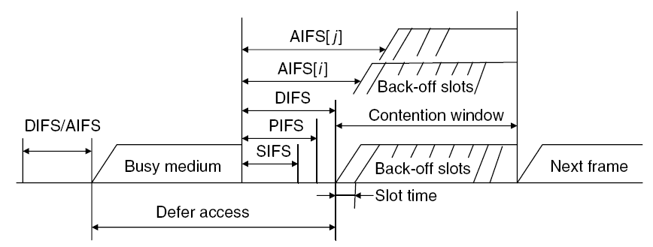
Relationship of different IFSs

Slide 49
Default EDCA parameter set

Slide 50
References
WMN textbook, 5.1─ 5.2
Communication Networks by A. Leon-Garcia
Data & Computer Communications by William Stallings

